Slide 1

Preserving Human Faces and Voices
Reflection Gathering on Pope Leo XIV’s Message for 60th World Day of Communications

Slide 2

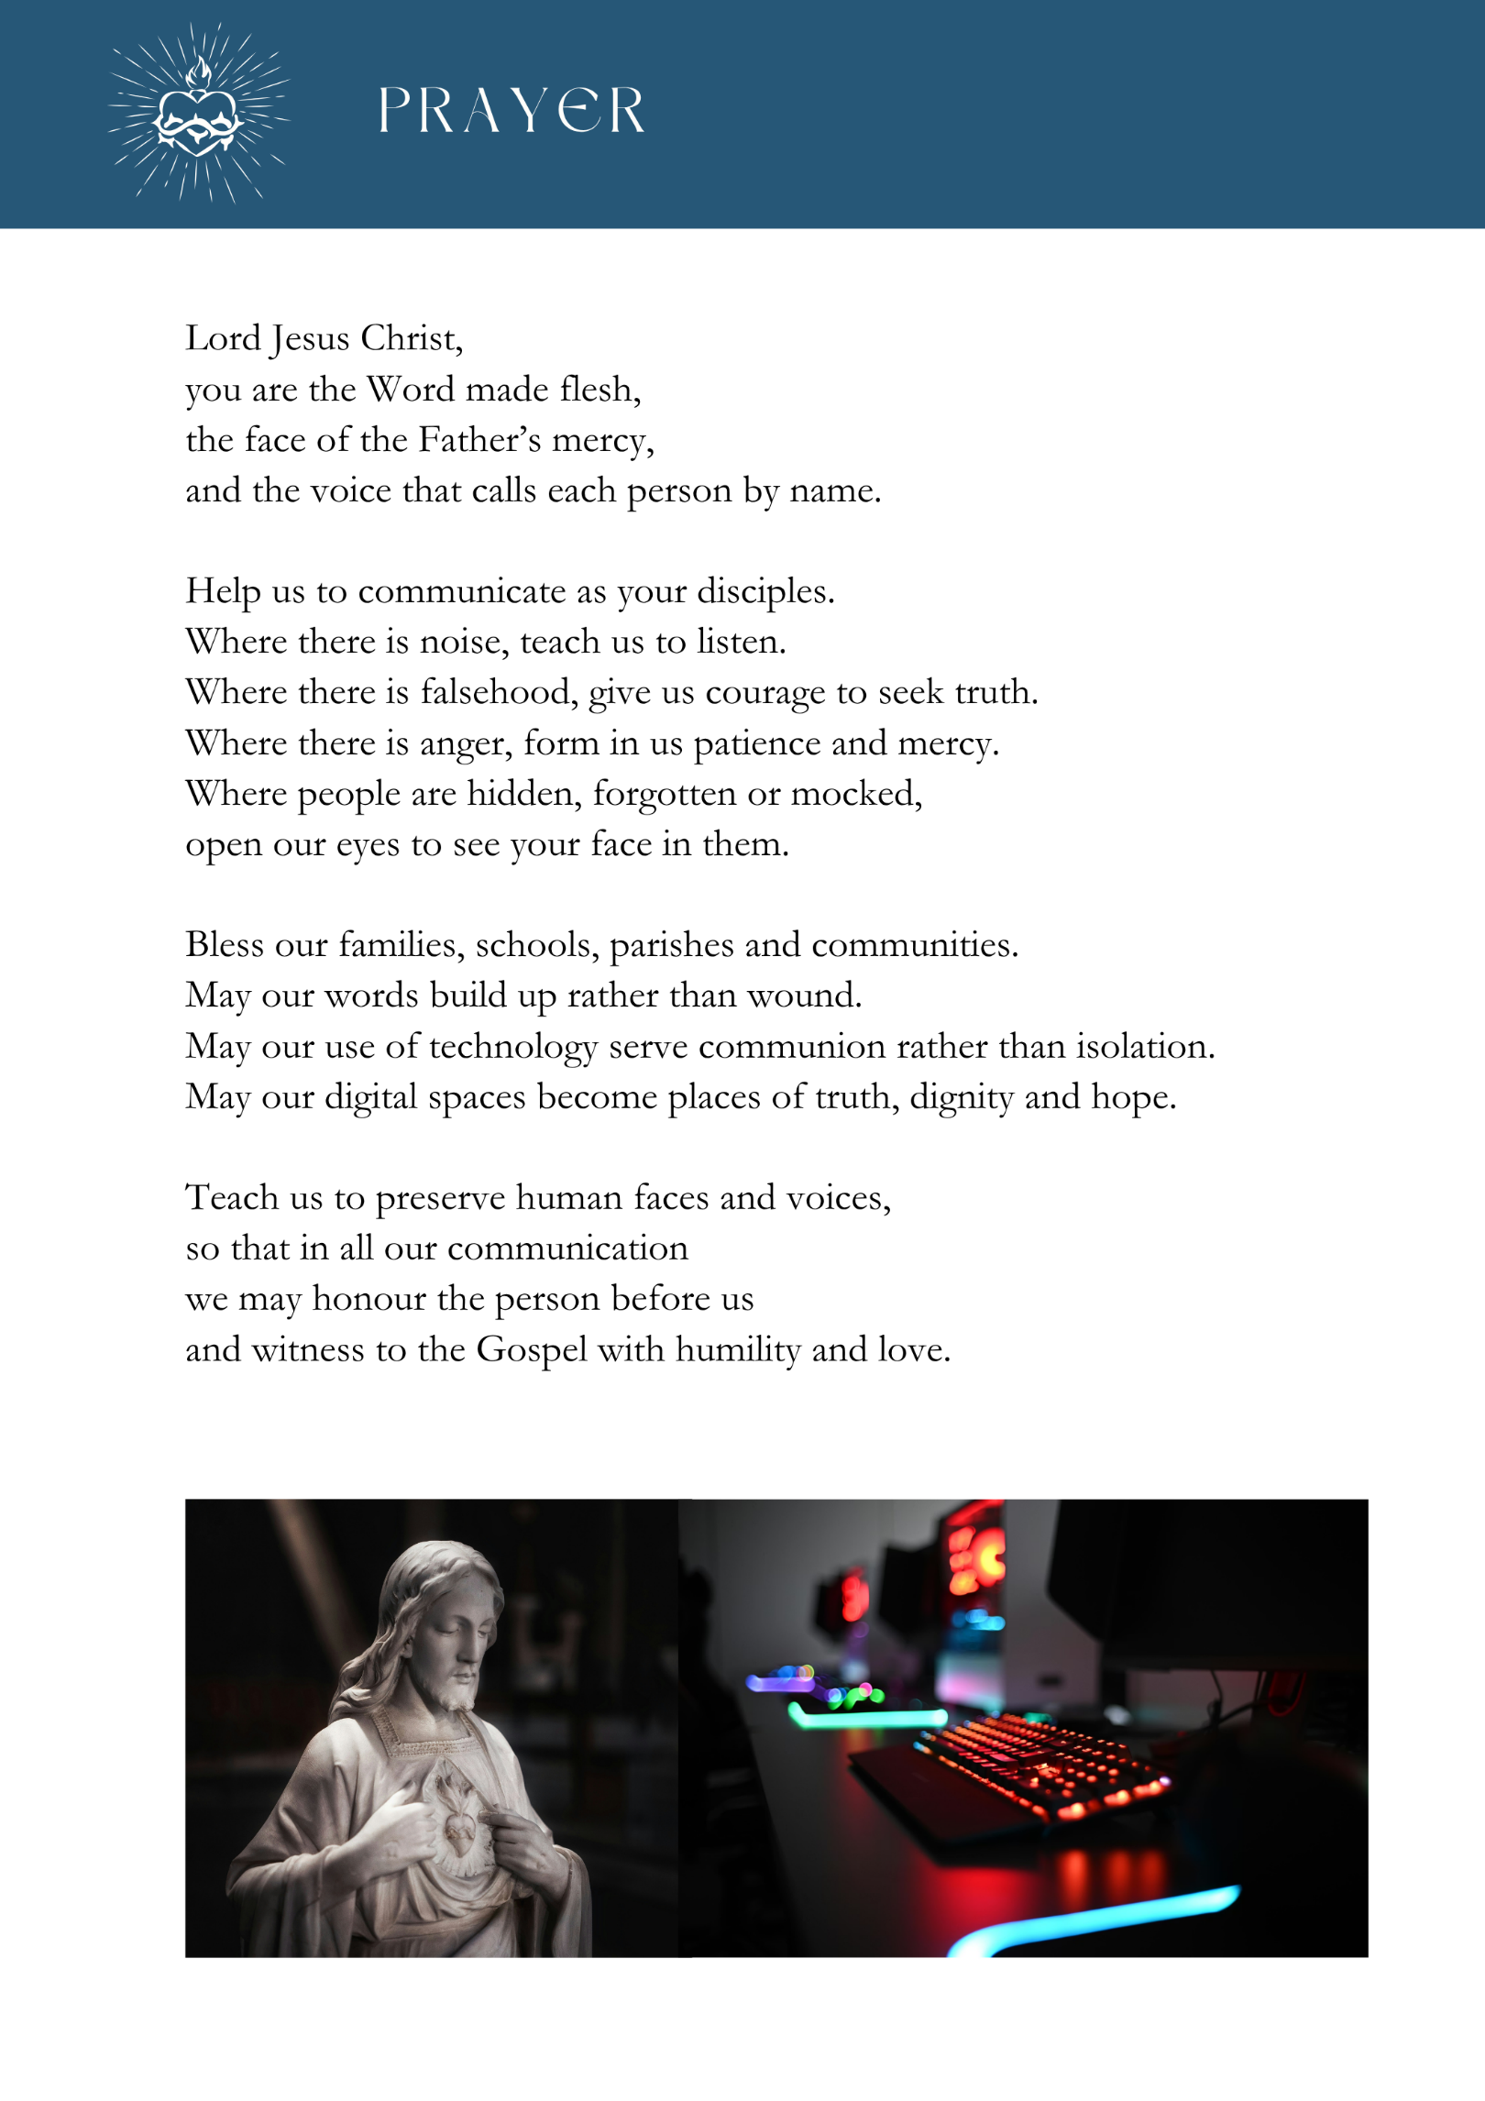
Welcome and Opening Prayer

Slide 3
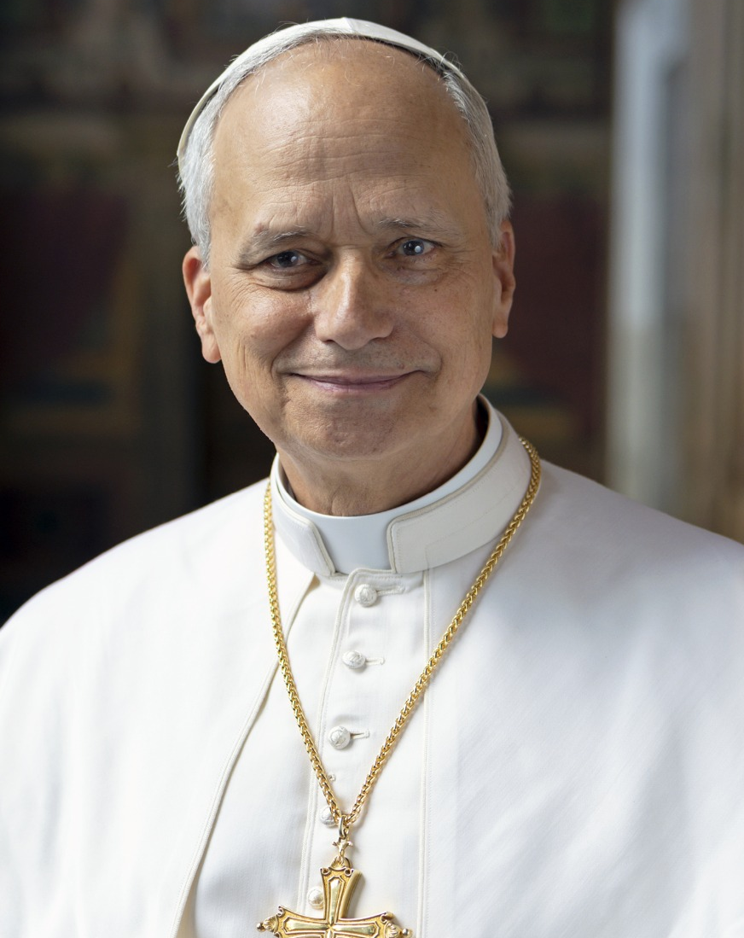
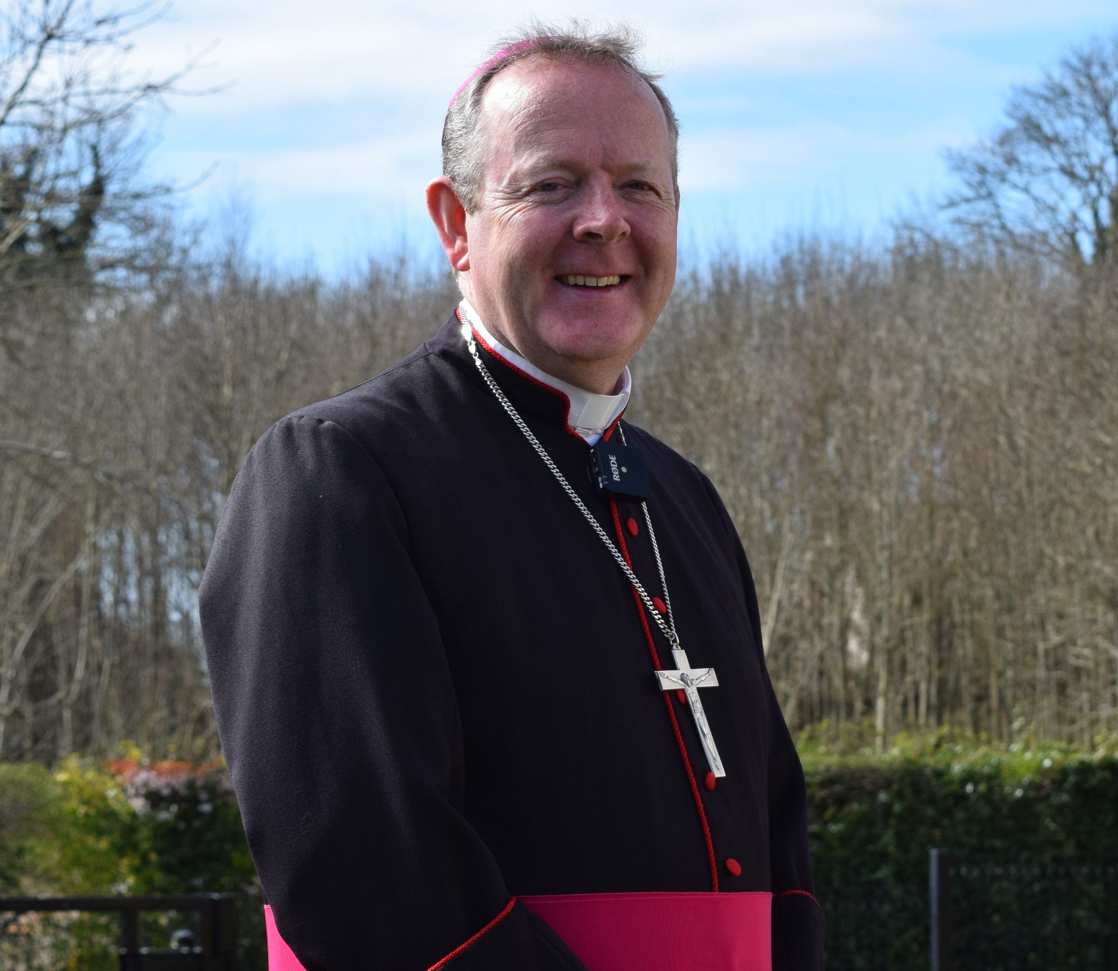
Read Pope Leo XIV’s Message and Archbishop Eamon’s Reflection

Slide 4

Round 1: Personal Reflection
Pause for silent reflection.
Share what is staying with you from what Pope Leo XIV and Archbishop are Saying.
What struck you, resonated with you, or is staying with you?
Make sure everyone gets a chance to share their thoughts

Slide 5
Round 2: Responding to Another
Pause for silent reflection.
Now share What have you heard from another person that you would like to respond to?
Make sure everyone gets a chance to share their thoughts

Slide 6
Round 3: What is God Calling Me/Us To
Having read what Pope Leo XIV and Archbishop Eamon Martin have said and listened to what each person has to say now consider the following question together:
What is God calling me, or us, to do going forward?
Find ways to realise these action points in your family, parish and community or in your work as a communicator.

Slide 7
Plenary Sharing on Insights from the Gathering

Slide 8
Closing Prayer

